Slide 1
Introduction to Node.js: Using Server-Side JavaScript

Slide 2
What is Node.js?
Node.js is a runtime environment that allows you to run JavaScript code outside the browser.
It is built on Chrome's V8 JavaScript engine.
Google originally developed this engine for Google Chrome. Later on, Node.js adopts this technology to enable JavaScript to run independently on top of Node.js.
Uses:
Backend development.
Building APIs.
Real-time applications (e.g., chat apps, gaming).

Slide 3
Introduction: Basic
In simple words Node.js is ‘server-side JavaScript’.
In not-so-simple words Node.js is a high-performance network applications framework, well optimized for high concurrent environments.
It’s a command line tool.
In ‘Node.js’ , ‘.js’ doesn’t mean that its solely written JavaScript. It is 40% JS and 60% C++.
From the official site:
‘Node's goal is to provide an easy way to build scalable network programs’ - (from nodejs.org!)

Slide 4
Introduction: Advanced
Node.js uses an event-driven, non-blocking I/O model, which makes it lightweight. (from nodejs.org!)
It makes use of event-loops via JavaScript’s callback functionality to implement the non-blocking I/O.
Programs for Node.js are written in JavaScript but not in the same JavaScript we are use to. There is no DOM implementation provided by Node.js, i.e. you can not do this:
var element = document.getElementById(“elementId”);
Everything inside Node.js runs in a single-thread.

Slide 5
Features of NodeJs
Asynchronous and Non-blocking: Handles multiple requests without waiting for the previous ones to complete.
Single-threaded: Uses one thread for execution but can handle many connections via its event loop.
Cross-platform: Works on Windows, macOS, and Linux.

Slide 6
Why Use Node.js for Server-Side Development?
Single Language: Use JavaScript both on the client-side and server-side, simplifying full-stack development.
Non-blocking I/O: Handles multiple requests asynchronously, making it highly scalable.
Event-driven Architecture: Supports real-time applications like chat or live streaming.
NPM (Node Package Manager): Offers over a million libraries for easy integration of functionalities.

Slide 7
Core Concepts Behind Node.js
Single-Threaded Architecture:
Node.js operates on a single thread using the event loop.
Unlike traditional server-side platforms that spawn multiple threads to handle concurrent requests, Node.js uses one thread to handle all requests.
Non-blocking I/O:
I/O (Input/Output) operations like reading files, accessing databases, or making API calls do not block the main thread.
Instead, they are delegated to the background workers.
Asynchronous Execution:
Node.js handles tasks asynchronously using callbacks, Promises, or async/await.

Slide 8
How Node.js Handles Requests
Client Sends a Request:
When a client (like a browser) sends a request to the Node.js server, the request is received by the event loop.
Delegating Tasks:
If the request involves I/O operations (e.g., reading a file or querying a database), the task is delegated to the worker threads or background processes.
Node.js does not wait for the task to complete; instead, it moves on to handle the next request.
Callback Mechanism:
Once the I/O operation is completed, the callback function registered for that task is executed.
The event loop ensures that the callback is added back to the main thread for processing.
Response Sent to Client:
Once the task is complete, the response is sent back to the client.

Slide 9
Components of Node.js Architecture
1. Event Loop
The event loop is the core of Node.js and is responsible for managing all asynchronous operations.
2. Worker Threads
These are part of Node.js's libuv library and handle heavy operations like file reading/writing, database queries, or encryption.
3. Event Queue
All incoming requests are added to the event queue.
The event loop processes these requests sequentially.
4. Thread Pool
Node.js uses a limited thread pool (default size: 4) provided by libuv for handling concurrent tasks.

Slide 10
Step-by-Step Workflow in Node.js
Initialization:
The server starts and initializes the event loop.
Receiving Requests:
Client requests are pushed to the event queue.
Event Loop Checks the Queue:
The event loop picks up requests from the queue.
Synchronous Tasks:
If the task is synchronous, it is executed on the main thread.
Asynchronous Tasks:
For tasks like database queries or file operations, the event loop delegates them to worker threads.
Callback Execution:
Once a worker thread completes the task, the result is sent back to the event loop.
The event loop executes the callback associated with the completed task.
Response Sent:
The server sends the response to the client.

Slide 11
Challenges in Node.js Architecture
Single Thread Limitations:
The single-threaded nature can be a bottleneck for CPU-intensive tasks.
Solutions:
Offload heavy tasks to worker threads or use child processes.
Use libraries like worker_threads or external tools like PM2 for scaling.
Callback Hell:
Asynchronous nature can lead to deeply nested callbacks.
Solution:
Use Promises or async/await.

Slide 12
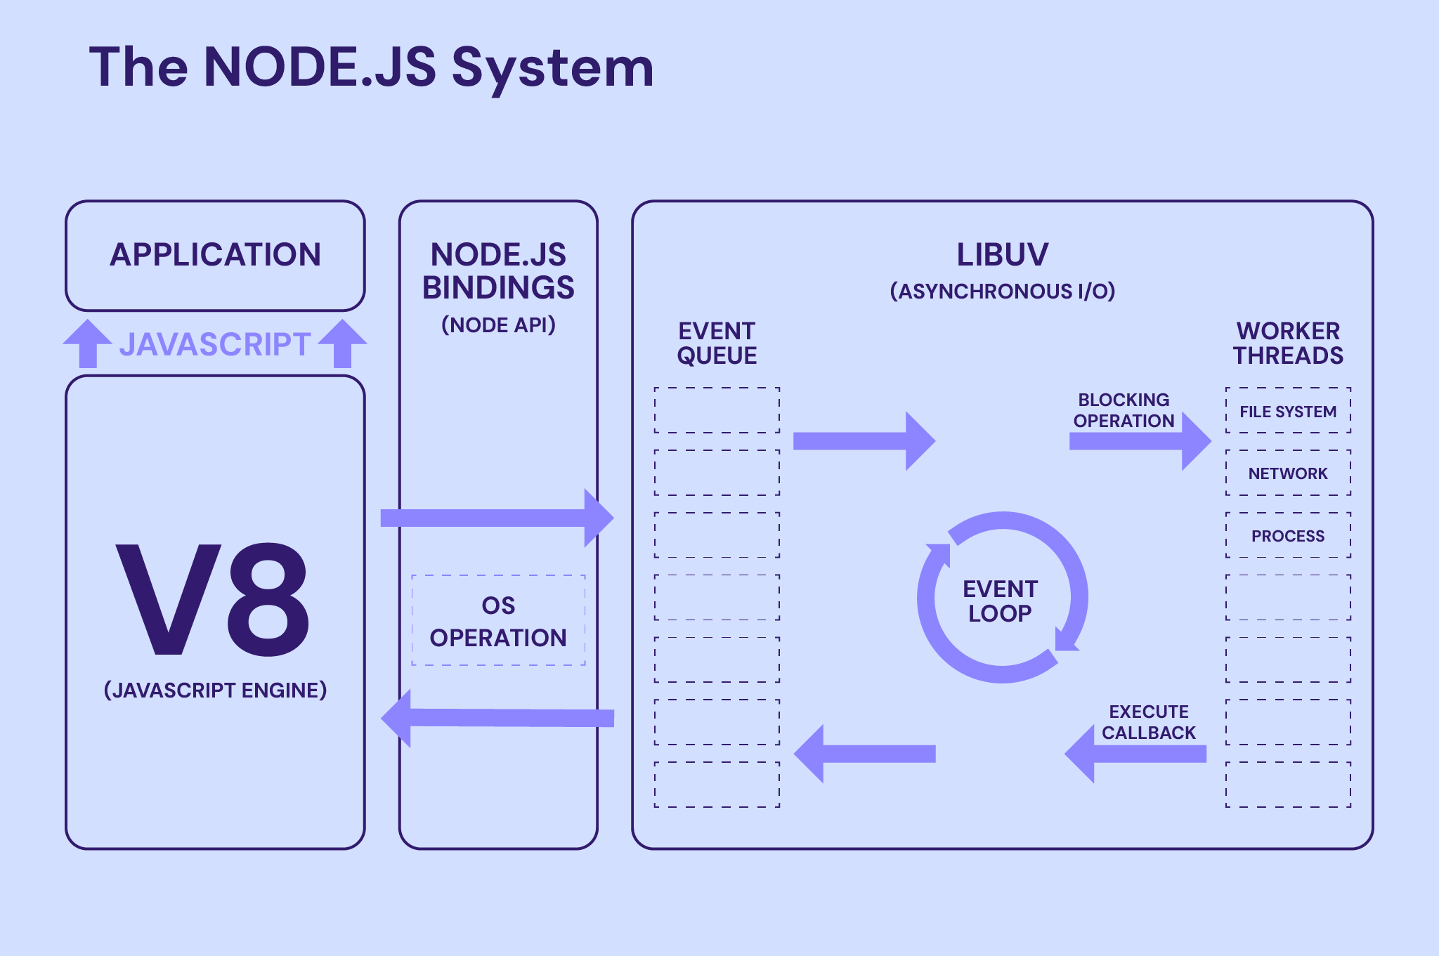

Slide 13
Why Use Node.js in MERN Stack?
MERN stands for MongoDB, Express, React, and Node.js.
Node.js serves as the backend of a MERN stack project, handling requests from the frontend (React) and interacting with the database (MongoDB).
The primary advantage is that you can use JavaScript for both client-side and server-side development.

Slide 14
Setting Up Node.js
Install Node.js from the official website
After installation, verify it by running the following commands
node -v
npm -v

Slide 15
Node Package Manager (NPM)
It is a tool for installing software, like modules or dependencies, for JavaScript applications.
It helps improve Node.js development efficiency by allowing users to access additional components from a single place.
The NPM repository currently houses millions of packages and modules, including the highly popular Lodash JavaScript library. You can also download other frameworks from the repository, like Express.js and Mocha.js.

Slide 16
Node.js Module System
The module system lets you load external libraries into your application.
That’ll enable you to take advantage of built-in Node.js modules as well as third-party npm modules.
This includes libraries for connecting to database, creating web servers, and more!

Slide 17
Importing Node.js Core Modules
Node.js comes with dozens of built-in modules.
These built-in modules, sometimes referred to as core modules, give you access to tools for working with the file system, making http requests, creating web servers, and more!

Slide 18
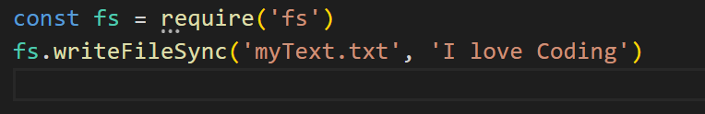
Importing Node.js Core Modules
The module system is built around the require function. This function is used to load in a module and get access to its contents. require is a global variable provided to all your Node.js scripts, so you can use it anywhere you like!
The script above uses require to load in the fs module. This is a built-in Node.js module that provides functions you can use to manipulate the file system. The script uses writeFileSync to write a message to notes.txt.

Slide 19
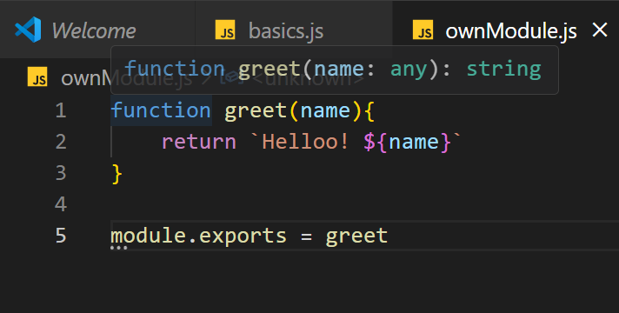
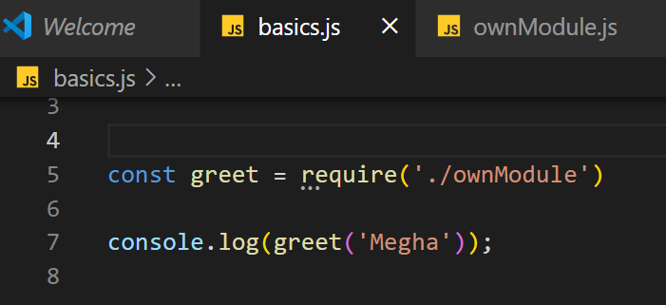
Importing Your Own Files

Slide 20
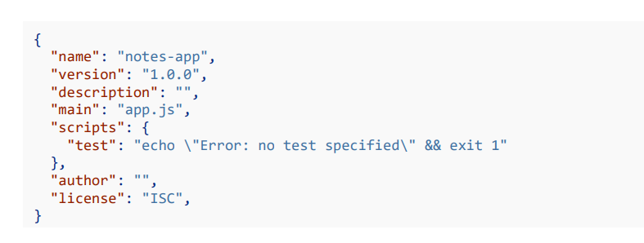
: Importing npm Modules
Your Node.js application needs to initialize npm before npm can be used.
You can run npm init from the root of your project to get that done.
That command will ask you a series of questions about the project and it’ll use the information to generate a package.json file in the root of your project.

Slide 21
: Global npm Modules and nodemon
Installing an npm Module Globally npm modules can be installed globally by adding a -g flag to the installation command.
Not all modules are designed to be installed globally
When you install nodemon globally, you get access a new nodemon command from the terminal. This can be used to start and Node.js application and then restart the application any of the app scripts change.
This means you won’t need to switch between the terminal and text editor to restart your application every time you make a change.

Slide 22

Run : nodemon app.js
Install :
You can stop nodemon by using ctrl + c from the terminal!

Slide 23
Creating a Web Server using the http Module
// Import the 'http' module from Node.js core library
const http = require('http');
// Create a server using the 'createServer' method
// 'req' represents the incoming request from the client and 'res' represents the response object used to send data back to the client
const server = http.createServer((req, res) => {
// Set the HTTP status code to 200 (OK) and specify the response content type as plain text
res.writeHead(200, { 'Content-Type': 'text/plain' });
// End the response and send the content 'Hello, Node.js Server!' back to the client
res.end('Hello, Node.js Server!');
});
// Start the server and make it listen on port 3000, The callback function runs when the server starts successfully
server.listen(3000, () => console.log('Server running on port 3000'));

Slide 24
Creating a server using Express
One of the most popular Node packages is called Express (it has 22,000,000 weekly downloads!)
It is a minimal web application framework that helps us set up a server and create APIs
https://expressjs.com/

Slide 25
Setting up package.json
First, let’s set up our package.json
Package.json is a universal file in Node.js that contains metadata about the Node packages installed, the project name and description, and other details
Run npm init

Slide 26
Creating a simple server with Express, part 1
Now we can install NPM (Node Package Manager) packages!
Run npm install express to install Express ○ You can read more about Express on their website https://expressjs.com/
This adds stuff to package.json and package-lock.json (a more specific version of package.json we will not touch) and also creates the folder full of our installs called node_modules
To let app.js know to use the Express module, we have to use:
const express = require(“express”);

Slide 27
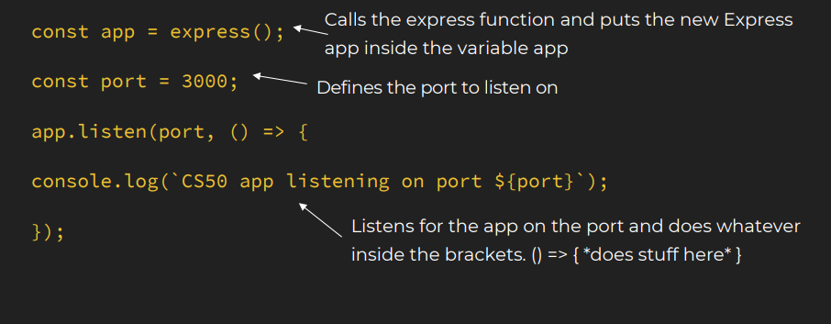
Creating a simple server with Express, part 2

Slide 28
Connecting Node.js to a Database
const mongoose = require('mongoose');
mongoose.connect('your_mongodb_connection_string')
.then(() => console.log('MongoDB Connected'))
.catch(err => console.error(err));

Slide 29
Who is using Node.js in production?
Yahoo! : iPad App Livestand uses Yahoo! Manhattan framework which is based on Node.js.
LinkedIn : LinkedIn uses a combination of Node.js and MongoDB for its mobile platform. iOS and Android apps are based on it.
eBay : Uses Node.js along with ql.io to help application developers in improving eBay’s end user experience.
Dow Jones : The WSJ Social front-end is written completely in Node.js, using Express.js, and many other modules.
Complete list can be found at: https://github.com/joyent/node/wiki/Projects,-Applications,-and-Companies-Using-Node

Slide 30
Tasks
What is Node.js, and how does it differ from traditional server-side technologies?
Why is Node.js preferred in the MERN stack for backend development?
Explain the event-driven architecture of Node.js and its significance.
What is the purpose of the npm (Node Package Manager) in a Node.js project?
How do you create a simple HTTP server in Node.js without using any framework like Express?
What is Express.js, and how does it enhance the capabilities of Node.js?
How can you handle errors in an Express.js application?
What are the common project folder structures used in Node.js, especially for MERN stack projects?
What is RESTful API, and how do you create a simple GET and POST API using Express?
What are environment variables, and how do you manage them in a Node.js application using dotenv?

